Slide 1
PRAYER COUNSELING SEMINAR I “Remove the wooden beam from your eye first; then you will see clearly to remove the splinter in your brother’s eye.” Luke 6:42b
March 7 & 8 2026
BLD Cebu Cluster
Notes:
1

Slide 2
WELCOME TO THE PRAYER COUNSELING SEMINAR
Community Objectives:
To enhance pastoral and healing gifts through prayer counseling
To develop more prayer counselors for the community
Notes:
2

Slide 3
WELCOME TO THE PRAYER COUNSELING SEMINAR
Course Objectives
To provide a clear view of Prayer Counseling, a Christ-centered inner healing ministry
To offer the opportunity to experience personal healing through small group ministry (practicum) .
Notes:
3

Slide 4
WELCOME TO THE PRAYER COUNSELING SEMINAR
Course Objectives: Continued
To provide a venue for building relationship, learning, and understanding.
To teach, model, and provide opportunity to practice in the elements of the ministry in: prayer healing, application of scriptural elements of healing.
To recognize and understand the common problems and patterns of difficulty.
Notes:
4

Slide 5
WELCOME TO THE PRAYER COUNSELING SEMINAR
Course Objectives: Continued
To help identify the wounds and roots of bitterness.
To offer small group learning opportunity in Basic Prayer Counseling skills: interviewing, active listening, prayer, and small group dynamics.
Notes:
5

Slide 6
WELCOME TO THE PRAYER COUNSELING SEMINAR
HOUSE RULES:
Prayer - all the time
Full Participation Needed (no timeout)
Avoid distractions - Cell Phones off until break time
Small Groups - are very important
Quiet time - Saturday night until Sunday worship
Notes:
6

Slide 8

INGREDIENTS OF PRAYER HEALING
FEBRUARY 11 - 12, 2023
METRO MANILA
Notes:
8

Slide 9
INGREDIENTS OF PRAYER COUNSELING
Recognition
Examining the fruit (Lk 6:43)
Asking questions (Is51: 1-2; Lk6: 46-49; Is 48:8)
“Tuning in” empathically through the Holy Spirit
Words of knowledge (1Cor 12:8)
Visions/dreams from the Lord
Notes:
9

Slide 10
INGREDIENTS OF PRAYER COUNSELING
Repentance
To exercise a godly grief (based on God’s Love), resulting in real change
Not merely wishing we’d done better but feeling sorry for ourselves
Sacrament of Reconciliation -Confessions of sins (Jam 5:16)
Notes:
10

Slide 11
INGREDIENTS OF PRAYER COUNSELING
Forgiveness
Forgive those who have hurt them (guilty or not)
Themselves
God
Notes:
11

Slide 12
INGREDIENTS OF PRAYER COUNSELING
Comfort for wounded spirit (2Cor 1:3-4)
To strengthen and encourage for the work that lies ahead
To comfort until the person is ready to continue – not beyond into self pity
Notes:
12

Slide 13
INGREDIENTS OF PRAYER COUNSELING
Prayer for the Counselee
For the right spirit (Ez 11:19)
For a new heart (Ez 11:19; 36:26)
For a new mind (Ep 4:17-18)
Bringing Structures to Death to the Cross (Col 3:5, 8-10; Ep 4:22-24; Rm 8:13)
Notes:
13

Slide 14
INGREDIENTS OF PRAYER COUNSELING
Disciplines to walk the new way
Provide strength and stability to the freshly healed spirit (2Tm 1:7; Col2: 5; Rm6: 11-14)
Deliverance
We have the authority to bind and to loose, as well as to exorcise when necessary (Mt 16:19; 18:18; 10:1)
Jesus warns us not to cast away demons without dismantling the house of character (Lk 11:24-26)
Notes:
14

Slide 15
INGREDIENTS OF PRAYER COUNSELING
Support Group (Community)
To love and encourage, and to speak truth (Eph4: 15)
Notes:
15

Slide 17

Biblical Basis
March 7 & 8 2026
BLD Cebu Cluster
Notes:
17

Slide 18
FOUR PRIMARY LAWS
Honor your father and mother. ( Dt 5:16)
2. Do not judge lest you be judge. (Mt 7:1-2)
3. What a man sow, this he will also reap. (Ga 6:7-8).
4. For in that you judge another, you condemn yourself (Ro 2:1)
Notes:
18

Slide 19
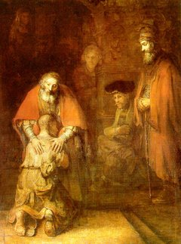
Law of Honoring Parents
Honoring …
Notes:
19

Slide 20

Honor Your Father and Mother
Notes:
20

Slide 21
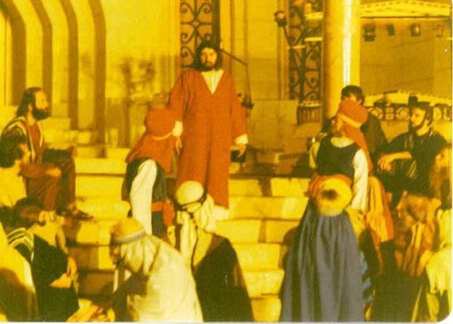
Law of Judging
Do not judge, or you too will be judged. For in the same way you judge others, you will be judged, and with the measure you use, it will be measured to you.
Notes:
21

Slide 22
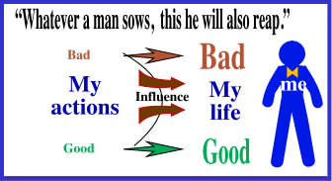
Law of Sowing and Reaping
Notes:
22

Slide 23
FOUR PRIMARY LAWS …
For in that you judge another, you condemn yourself (Ro 2:1)
- We do not acquire the sins of others because we judge; we are already fellow sinners by nature, doing those same sins.
- Judging condemns us to blindly continue the same sins, making us unable to avail ourselves of God’s grace and healing.
Notes:
23

Slide 24
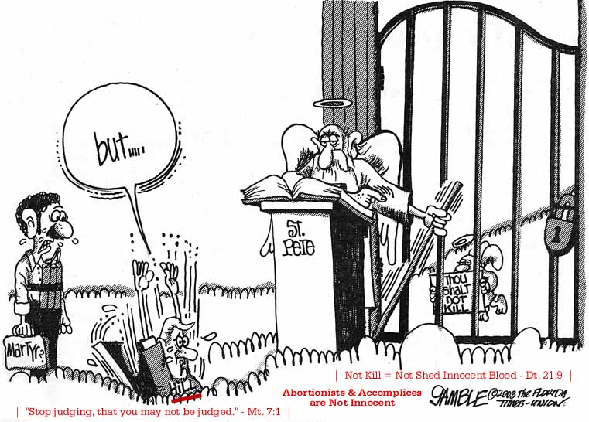
"Judge Not, that you be not judged." [Mt. 7:1 KJV]
The spiritual person, however, can judge everything
but is not subject to judgment by anyone. [1 Cor. 2:15]
Notes:
24

Slide 25
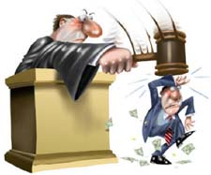
For in that you judge another, you condemn yourself (Ro 2:1)
Notes:
25

Slide 26
Add to these laws the principle of increase
“ For they sow the wind, and they reap the whirlwind….” Ho 8:7a
2. “ … Still other seed fell on good soil, where it produced a crop – a hundred, sixty or thirty times what was sown.” Mt 13:8
Notes:
26

Slide 27

…as though there is an inner child
Notes:
27

Slide 28
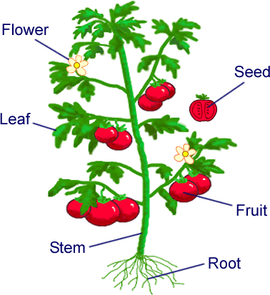
Fruit to Root
Notes:
28

Slide 29
FOUNDATIONS FOR MINISTRY
Discernment of root issues is founded
upon laws in the Word of God that are:
written in the universe
applies to all
absolute and eternal
Notes:
29

Slide 30
Why Healing & Transformation?
Although Christ has accomplished our salvation and perfection, our carnal nature, though slain at the cross, refuses to stay dead. It comes back to life, causing trouble.
See to it that no one comes short of the grace of God; that no root of bitterness springing up causes trouble, and by it many are defiled” Hb 12:15
Notes:
30

Slide 31


…it keeps on coming back
Manifestations/fruits
Structure/strongholds
Notes:
31

Slide 32
Why Healing & Transformation?
“ Take the plank of your own eye, and then you will see clearly to take out the speck that is in your brother’s eye.” Lk 6:42
“ Bad fruit comes from bad roots.” Lk 6:43
“ What a person expresses comes from the treasure of his heart.” Lk 6:45
“ Why do you call me ‘Lord, Lord’ and do not do what I say.” Lk 6:46
Notes:
32

Slide 33
ROLE OF PRAYER COUNSELOR
Evangelists to unbelieving areas of a believer’s heart
Shepherd the soul and exhort to bring the old nature to death
Encourages Confession of sin
Notes:
33

Slide 34
ROLE OF PRAYER COUNSELOR . . .
Help effect in the process of sanctification and transformation.
Help overcome structures (practiced habits).
Help establish and restore true identity in Christ rather than strong self image
Notes:
34

Slide 35
SOME ERRORS IN THE MINISTRY
That’s in the past. Forget it.
Reading scriptures, preaching and assuming person will alter behavior
Comforting only, without the efficacy of forgiveness
Healing the wounds without first exploring the nature of woundedness.
Notes:
35

Slide 36
SOME ERRORS IN THE MINISTRY
Demanding repentance or forgiveness before the person is ready.
Heal the root without understanding fully the fruit
Assuming problems originate with demons or ‘spirits’ rather than from sin
Becoming emotionally involved with, failing to discern transference
Notes:
36

Slide 37
A PRAYER OF THANKS
Clearly, Lord, even clarification through the law didn’t keep me from sin. Please forgive me. Help me get to your cross so that my sinful nature can die, that I might be resurrected in You, with Your life and nature. Forgive me for casting You in the role of a harsh taskmaster. Touch my eyes that I may see You s You are, my loving, heavenly Father. Show me those judgments I've made when I was hurt, angry, and bitter ----and apply Your healing touch to them.
I thank you Lord o the truth of Your laws, and the security and safety they give me. Help me to treasure each one in my heart as gifts from You, our Father in heaven. In Jesus’ name, Amen
Notes:
37

Slide 38
A PRAYER OF THANKS
Lord, I thought I knew You and understood Your Law. Now I see that I was wrong. I missed the goodness and blessing built into Your law, seeing it only as do’s and don’ts. I didn’t see your discipline as coming from a loving Father, designed to clarify what I misunderstood.
If I understood how sowing and reaping affects my life, how judgment lock me into the very behaviors and attitudes condemn, if I had understood how to respond in love, generosity of heart and forgiveness, I would have long ago brought the old to death and arisen the new.
Notes:
38

Slide 40
What Should Happen in Small Groups
Foundation Verse:
Do nothing out of selfish ambition or vain conceit, but in humility consider others better than yourselves. Each of you should look not only to your interests, but also to the interests of others. Philippians 2:3-4
March 7 & 8 2026
BLD Cebu Cluster
Notes:
40
1. To make other people more important

Slide 41
SMALL GROUPS
Purpose
To train and equip to minister healing to others
Key Component
To provide an environment for participation
Notes:
41
Purpose- We are the body of Christ. We belong to God’s family. And God’s family help one another – reaching out and healing one another. We are mirrors for one another. My husband is my mirror. My husband can tell me what I look like. My husband can tell if I look pretty or ugly. My husband can tell me if I am nice or I am difficult. So is Cathy. She is my mirror. Cathy can tell me in our DCS meetings if I am right or wrong in my perceptions. We are created for each other – in the body of Christ.
2. Later we are going to discuss the dynamics of the small groups. Small groups are key in our practice of the prayer counseling principles.

Slide 42
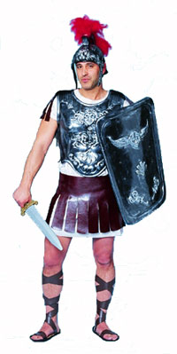
Help Others in Putting on the Armor of God
Helmet of Salvation
Breastplate of Righteousness
Buckle of Truth
Shield of Faith
Sword of the Spirit
Sandal of Peace
Notes:
42

Slide 43
SMALL GROUPS
Small group includes:
Opening prayer
A brief review of the teaching
Communication of personal responses to the teaching
Listening, listening, listening
Practicing counseling principles learned in teaching
Prayer for one another
Offer of love, hope, encouragement and closure to those receiving counseling
Notes:
43

Slide 44
SMALL GROUPS
Components of Small Groups:
Counselee
Counselor
Prayer Warrior
Notes:
44

Slide 45
SMALL GROUPS
Small group Dynamics:
Each in small group will take turns to be counselee and the rest are counselors
Each Counselee will have about 20 min to be ministered to
Each will take turns to be a lead counselor
Lead counselor will watch the time
While a counselor speaks, the other prays
If a counselee need more time, you can continue after dinner or break
Because of time limitations, you may continue counseling even after the weekend SEMINAR.
Be accountable to one another
Notes:
45
1. Counselors will take turns to ask questions, to probe.

Slide 46
SMALL GROUPS
Role of Lead Counselor:
Facilitates and empowers
Makes sure all have time to share, limits “talkers” and draws out quiet ones
Helps protect those receiving counseling from
Too many questions
Advice-giving
Conclusion-jumping
Premature ministry or pressure to confess, forgive, repent
Any emotional or spiritual violation
Notes:
46

Slide 47
SMALL GROUPS
Role of Lead Counselor:
Monitors general progress
Clarifies starting, stopping times; begins and ends meetings on time
Helps to set tone and pace of group experience
Helps to keep group focused
Helps to recognize limitations of group and recommend one-on-one counseling when needed to the teachers
Notes:
47

Slide 48
SMALL GROUPS
Role of Lead Counselor:
Participates in small group
Helps to model principles for healing: risking, trusting, confession, repentance, forgiveness
Allows others to minister to him/her
Notes:
48

Slide 49
SMALL GROUPS
Group member Responsibilities:
To honor group confidentiality
To risk and trust in relationship with others
To stay focused, involved on task
To support selected lead counselor in all areas of leader responsibilities
Follow BLD’s - L I P J A S
Notes:
49

Slide 50
SMALL GROUPS
Small group guidelines:
To actively listen to one another
Create an atmosphere of trust
Establish relationship
Give yourself time to discern and pray
To ask questions
Expand and clarify your understanding
Enable the person to find release talking it out
Notes:
50

Slide 51
SMALL GROUPS
To discern needs and respond sensitively
Even when experience or knowledge leads you to suspect certain roots to problems, it is important to respond carefully
Store information/understanding/revelation for later confirmation
Don’t interpret too soon
Don’t insist on the correctness of your discernment
Don’t gang up or ply with questions
Notes:
51

Slide 52
SMALL GROUPS
Listen to God throughout prayer counseling time. Expect to hear God through:
Visions
An audible voice (rare)
Words of knowledge
Dreams
Act on the basis of what you’ve learned
Treat one another with the gentleness and sensitivity Jesus would use
Notes:
52

Slide 53
SMALL GROUPS
Small group guidelines:
Ask permission to touch, pray for, and honor “no”
Never use guilt/condemnation to try to motivate someone to deal with an issue
Realize that some need to “stay” in their pain for a while, feeling understood and receiving comfort. Do not jump to get them healed.
Begin and end on time.
Notes:
53
End in prayer: A Prayer for Small Group (pg35)

Slide 54
SMALL GROUPS
Lovingly call to obedience
Suggest appropriate healing assignments when time is right
Making amends
Affirming the truth
Establishing new patterns
Praying daily
Encourage availing of the Sacraments of Reconciliation and Holy Eucharist
Notes:
54

Slide 55
SMALL GROUPS
Blessings of Small Groups
Building trusting relationships
Learning to trust God and to hear His voice
Learning to risk
Working through conflict
Developing our gifts
Learning from the experiences and wisdom of others
Being listened to, prayed for, ministered to
Beginning new healing in our life
Notes:
55

Slide 56
SMALL GROUPS
Sample Prayer for Small Groups
Lord, we thank you for choosing us, for being father to us. We bless you, for the love you have poured out over us but we also confess that we don’t fully understand your love or your fatherhood, nor do we know how to relate to each other as family.
Notes:
56

Slide 57
SMALL GROUPS
Prayer…
We know that as descendants of Adam and Eve we do not see ourselves in others as you do. We don’t hear, speak or react as your children. Thank you for providing this small group for us to learn your ways. Father, touch our eyes so we may see ourselves and each other as you see us. Touch our ears so we may hear each other’s heart and not just the words. Touch our hearts that we might be moved by that which moves you, that we respond as you would respond. Touch our minds so we understand what you want us to understand.
Notes:
57

Slide 58
SMALL GROUPS
Prayer…
Make us safe people, Lord. Help us to become like little children so we can enter into your kingdom. Bless our small group time; keep it a safe place for us to see, touch, taste what your kingdom is like. Just like little children, we need to experiment, to risk, to try our gifts. Meet each of us where we are. Thank you for not being a demanding parent. You never acquire of us what we are not prepared to accomplish. Amen.
Notes:
58

Slide 59
GUIDE FOR SMALL GROUP I
Opening Prayer (Small Group Prayer or others)
Short Introductions
Role Assignment: Lead Counselor, Counselee, Prayer Warrior (rotate each 20 minutes).
Review of Teachings Covered:
Four Basic Laws – which one affected you most?
Fruit to Root – what are the fruits you are reaping now?
Repentance & Restitution – is there unforgiveness in your life?
Counselor starts practicing his role by encouraging counselee to share reflections or personal ‘struck’ regarding previous lessons.
Prayer Warrior prays and intercedes but also ‘in’ participation and keeping ‘time’
Counselee respond to questions /clarifications/ paraphrasing /confirming /probing /… all related to the covered teachings.
Summarize the session with Counselee’s insights and understanding about the sharing of the Counselee ….leading to a prayers of Recognition and Repentance
Switch Roles and end the Small Group Session with a Prayer
Encourage members of the group to meet during break time or meal time.
Notes:
59

Slide 60
GUIDE FOR SMALL GROUP II
Opening Prayer (Small Group Prayer or others)
Short Review/Planning/Summary
Role Assignment: Counselor, Counselee, Prayer Warrior (rotate each 20 minutes).
Review of Teachings Covered:
Four Basic Laws – can you relate all your difficulties to these laws?
Fruit to Root – can you recognize the most bitter fruit you are reaping now?
Repentance & Restitution and Accomplishing Forgiveness – what are the key ingredients to accomplish forgiveness?
Bitter Roots – how is this affecting you and your relationship to others?
Counselor starts practicing role by encouraging counselee to share reflections or personal ‘struck’ regarding previous lessons.
Prayer Warrior prays and intercedes but also ‘in’ participation and keeping ‘time’
Counselee responds to questions as Counselor clarifies/paraphrases /confirms/probes/… all related to the covered teachings.
Summarize the session with Counselor’s insights and understanding about the sharing of the Counselee ….leading to a prayers of Recognition and Repentance, using Sample Prayers as guide.
Switch Roles and end the Small Group Session with a Prayer.
Remind members of the group to meet during break time or meal time.
Notes:
60

Slide 61
GUIDE FOR SMALL GROUP III
Opening Prayer (Small Group Prayer or others)
Short Review and Summary.
Role Assignment: Counselor, Counselee, Prayer Warrior (rotate each 20 minutes).
Review of Teachings Covered:
Four Basic Laws – which have you disobeyed the most?
Fruit to Root – can you recognize the most bitter fruit you are reaping now?
Honoring – what are you reaping now because of dishonoring your parents?
Basic Trust – how do you react when basic trust is broken?
What are your traits that others can say that your are a Performance Oriented person?
What experiences do you have will qualify you to be a good a good counselor?
Counselor starts practicing role by encouraging counselee to share reflections or personal ‘struck’ regarding previous lessons.
Prayer Warrior prays and intercedes but also ‘in’ participation and keeping ‘time’
Counselee responds to questions as Counselor clarifies/paraphrases /confirms/probes/… all related to the covered teachings.
Summarize the session with Counselor’s insights and understanding about the sharing of the Counselee ….leading to a prayers of Recognition and Repentance, using Sample Prayers as guide.
Switch Roles and end the Small Group Session with a Prayer.
Encourage members of the group to meet later and continue the contacts in the future.
Notes:
61

Slide 63
PRAYER COUNSELING SEMINAR WRAP-UP
March 7 & 8 2026
BLD Cebu Cluster
Notes:
63

Slide 64
“..Take the plank out of your own eye, and then you will see clearly to take away the speck that is in your brother’s eye.” Lk 6:42b
Notes:
64

Slide 65

“..Take the plank out of your own eye, and then you will see clearly to take away the speck that is in your brother’s eye.” Lk 6:42b
BLD

Slide 66
FOUR PRIMARY LAWS
Honor your father and mother. ( Dt 5:16)
2. Do not judge lest you be judge. (Mt 7:1-2)
3. What a man sow, this he will also reap. (Ga 6:7-8).
4. For in that you judge another, you condemn yourself (Ro 2:1)
Notes:
66

Slide 67
Four Primary Laws: Honor your father and mother. ( Dt 5:16)

Slide 68
Four Primary Laws: Do not judge lest you be judge. (Mt 7:1-2)
Do not judge, or you too will be judged. For in the same way you judge others, you will be judged, and with the measure you use, it will be measured to you.

Slide 69
Four Primary Laws: What a man sow, this he will also reap. (Ga 6:7-8).

Slide 70
Four Primary Laws: For in that you judge another, you condemn yourself (Ro 2:1)
MR. ME
I JUDGE YOU GUILTY
MR. I

Slide 71
WRAP-UP: PRAYER COUNSELING SEMINAR
Community Objectives:
To enhance pastoral and healing gifts
To develop more prayer counselors
Notes:
71

Slide 72
WRAP-UP : PRAYER COUNSELING SEMINAR
Course Objectives: Continued
Building relationship, learning, and understanding.
Prayer healing, application of scriptural elements of healing, recognition of common problems and patterns of difficulty, identification of wounds and roots of bitterness.
Learning in: interviewing, active listening, prayer, and small group dynamics.
Notes:
72

Slide 73
WHAT IS NEXT?
CONTINUE TO PRACTICE “LOGGING”
START “HEALING”
FAMILY
MINISTRY
“You are now an authority because you have overcome your wounds”
Notes:
73

Slide 74
Help Others in Putting on the Armor of God
Helmet of Salvation
Breastplate of Righteousness
Buckle of Truth
Shield of Faith
Sword of the Spirit
Sandal of Peace

Slide 75
WHAT IS NEXT?
BE WHAT YOU CAN BE :
JOIN THE MISSION
BRING BLD OUT THERE
SPREAD THE “GOOD NEWS”
Notes:
75

Slide 76

WHAT IS NEXT?
CONTINUE TURNING YOUR “ SWITCH”
S
W
I
T
C
H
….not witch !
Notes:
76

Slide 77
WHAT IS NEXT?
TURN ON YOUR “SWITCH”
S heperds
W itness
I ntercessors
T eachers
C ounselors
H ealers

Slide 78
WHAT IS NEXT?
CONTINUE SMALL GROUP
PRACTICE, PRACTICE
CONTINUE STUDIES - NEXT SEMINARS (
THANK YOU
Notes:
78

Slide 80
SEMINAR EVALUATION SHEET
 | Please help us improve by rating the following questions using the scale of 1 (poor) to 5 (best) | 1 | 2 | 3 | 4 | 5
 | Schedule and proper use of time
 | Seminar venue and conference room
 | Handouts and materials
 | Presentations of Teachers
 | Small Group Sessions
 | Applicability to your growth
 | Did it meet your expectations
 | Which did you like best?
 | What should be improved?

